Slide 1
Can Changes in Hot Spring Composition Reflect Decadal-Scale Deformation of the Yellowstone Caldera?
Justin R. Baez | Everett L. Shock
The School of Earth and Space Exploration
Thank you to the GeoPig team, who’s support, and criticism made this project possible.

Slide 2
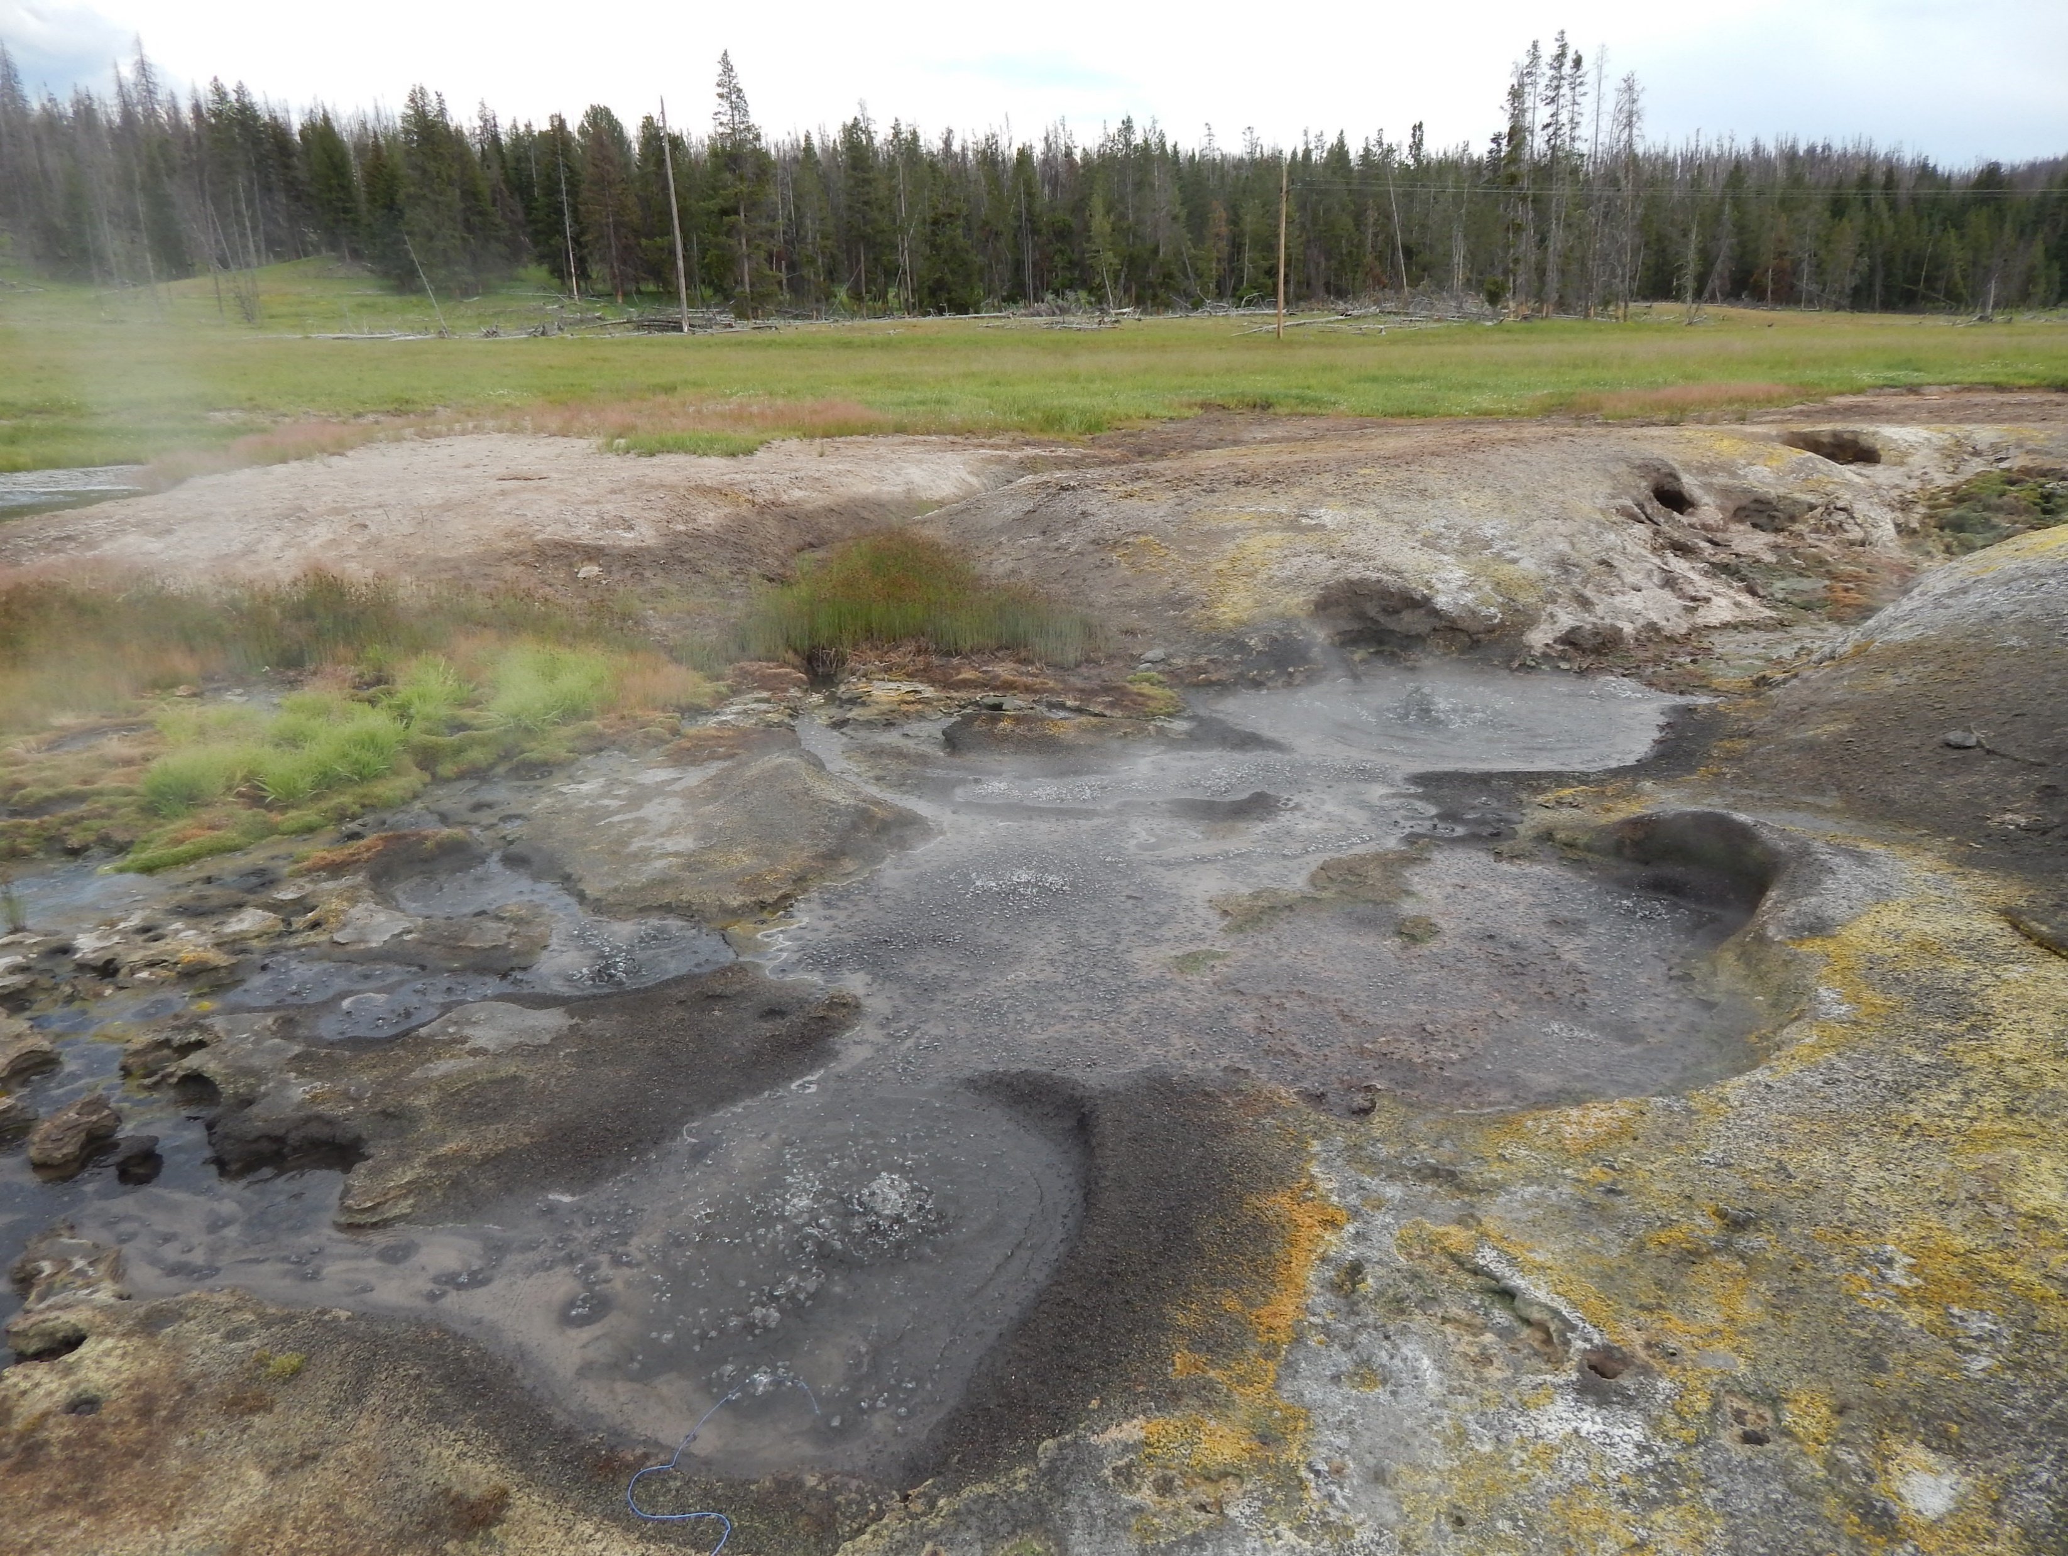
Yellowstone National Park (YNP)
YNP is home to a large caldera that formed ~600 Ka.
The Caldera contains naturally forming pools known as hot springs that are comprised of various dissolved solutes.
The hot springs at YNP provide a means of understanding subsurface conditions that range from large-scale deformation to the mechanisms regarding volcanic or gaseous outputs.
Caldera Boundary
Obsidian Pool
Photo by Everett Shock, Research Permit Study # YELL-05434
Sourced from (Waite and Smith, 2002)
Notes:
The goal for the text is to provide a more in-depth background of the features of hot springs and the caldera while I stick to my project.

Slide 3
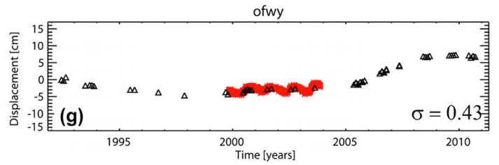
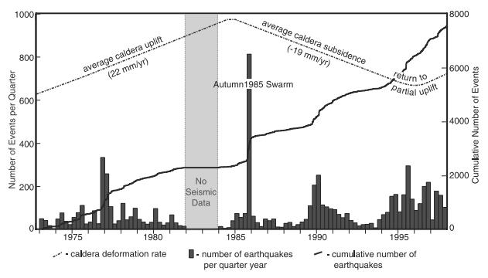
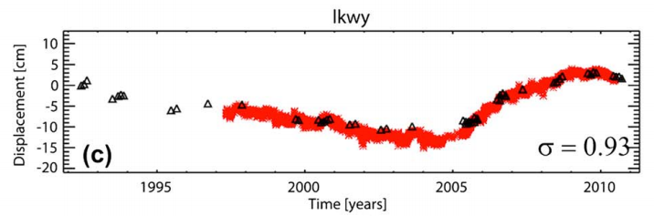
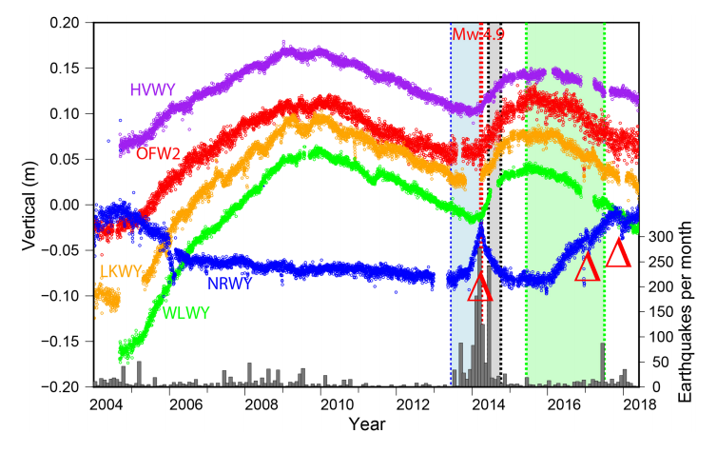
Background (1)
Sourced from (Waite and Smith, 2002)
Sourced from (Tizzani et al., 2015)
Subsidence
Uplift
Subsidence
Uplift
~2000-2004
2004-2010
2010-2014
2014-2015
There are many models and studies that suggest the observed deformational change to be reflected in YNP hot springs, but this is one of the first studies at the park to attempt this analysis.
Sourced from (Wicks et al., 2020)
Notes:
There are many model that suggest the deformational change to be reflected in YNP hot springs, but this is one of the first studies at the park to have attempt this analysis.

Slide 4
Background (2)
Caldera Boundary
LKWY
OFW2
Sourced from (Wicks et al., 2020)
Sourced from (Wicks et al., 2020)
The colored lines on the graph indicate uplift as a function of time.
This study investigates how change in character from uplift to subsidence (and vice versa) are reflected within the composition of hot springs.
Modified from (Waite and Smith, 2002)

Slide 5

Observations (1)
Subsidence
Uplift
Subsidence
Uplift
pH reflects the acidity or alkalinity of a hot spring system. The hot spring will need to become saturated or diluted in hydrogen ($H^{+}$) ions to cause a large (multi-magnitude) shift in pH.
~2000-2004
2004-2010
2010-2014
2014-2015
The red dashed lines show the approximate division between changes in deformation character.
The blue dots represent an individual measurement taken of a hot spring for the corresponding year.
Temperature provides context into how the system is responding to changes (if there are any).
Notes:
Walk my audience through my plots and why they are interesting.

Slide 6
Observations (2)
Subsidence
Uplift
Subsidence
Uplift
Chloride measurements are insightful of where the water came from. Changes in chloride will reflect changes in subsurface conditions.
~2000-2004
2004-2010
2010-2014
2014-2015
Sulfate is the dominantly controlling factor of pH in YNP hot spring systems. If there is a change in pH, sulfate is usually the mechanism influencing the change.

Slide 7
General Analysis
We are observing changes (and lack of changes) in YNP hot spring compositions in different regions of the park.
The hot springs throughout the park change differently throughout the same time-frame.
If these changes are related to the deformation, a possible explanation would be to attribute the chemical changes to changes in the distribution of materials in the subsurface in response to deformation activity.
Caldera Boundary
LKWY
OFW2
Modified from (Waite and Smith, 2002)
Notes:
Discuss further analysis here.

Slide 8
Citations
- Tizzani, P., M. Battaglia, R. Castaldo, A. Pepe, G. Zeni, and R. Lanari (2015), Magma and fluid migration at Yellowstone Caldera in the last three decades inferred from InSAR, leveling, and gravity measurements, J. Geophys. Res. Solid Earth, 120, 2627–2647, doi:10.1002/2014JB011502
- Wicks, C. W., Dzurisin, D., Lowenstern, J. B., & Svarc, J. (2020). Magma intrusion and volatile ascent beneath Norris Geyser Basin, Yellowstone National Park. Journal of Geophysical Research: Solid Earth, 125, e2019JB018208. https://doi.org/ 10.1029/2019JB018208
- Dzurisin, D., Savage, J. C., & Fournier, R. O. (1990). Recent crustal subsidence at Yellowstone caldera, Wyoming. Bulletin of Volcanology, 52(4), 247-270.
- Hurwitz, S., and J. B. Lowenstern (2014), Dynamics of the Yellowstone hydro thermal system, Rev. Geophys., 51, 375–411, doi:10.1002/2014RG000452.
Thank you for listening!

